Slide 1
WHAT IS SOLAR POWER?
By: Lila Nelson
Marketing Intern, ReVision Energy
UNH Sustainability Fellow

Slide 2
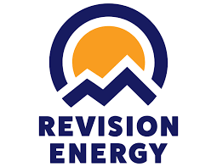
About ReVision Energy
ReVision is a Certified B Corporation that follows the moto of "People, Planet, Profit" to ensure their work is not harmful to the environment
Total of 5 branches across New England with over 300 employees
Won several awards including #1 Rooftop Installer in Northern New England, Greenest Contractor, Business of the Year, and Best of the World B Corp

Slide 3
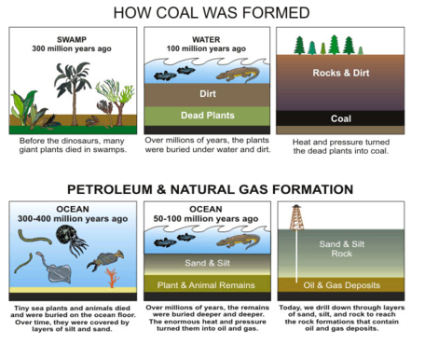
What are Fossil Fuels?
Created by fossilized plants and animals
Pressure turns them into resources to be extracted and turned into energy

Slide 4
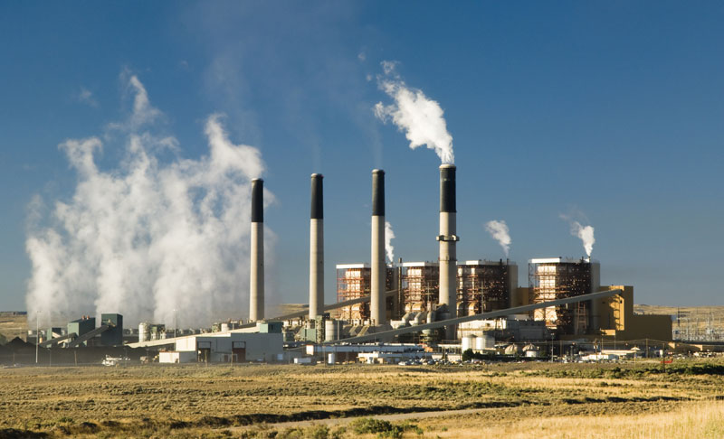
Examples of Fossil Fuels
Examples of fossil fuels are... coal, oil, natural gas, and nuclear power
Can anybody think of WHERE fossil fuels are used?
Where do you use fossil fuels?

Slide 5
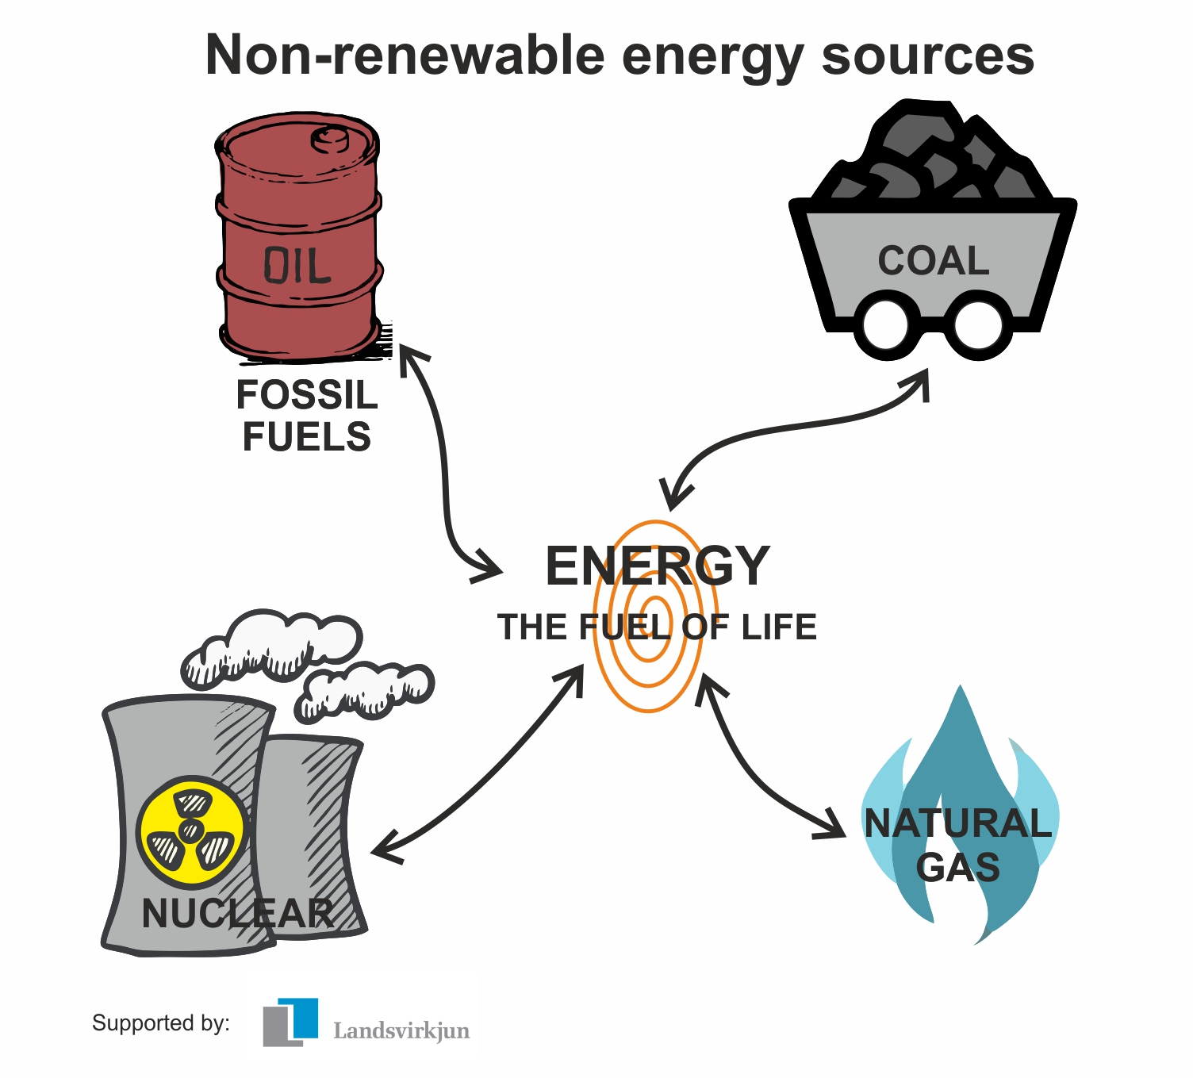
Non-Renewable Resources
Non-renewable resources, also known as fossil fuels are FINITE and will run out
Based on current consumption rates, we have 50-100 years left of different non-renewables
Then what?

Slide 6
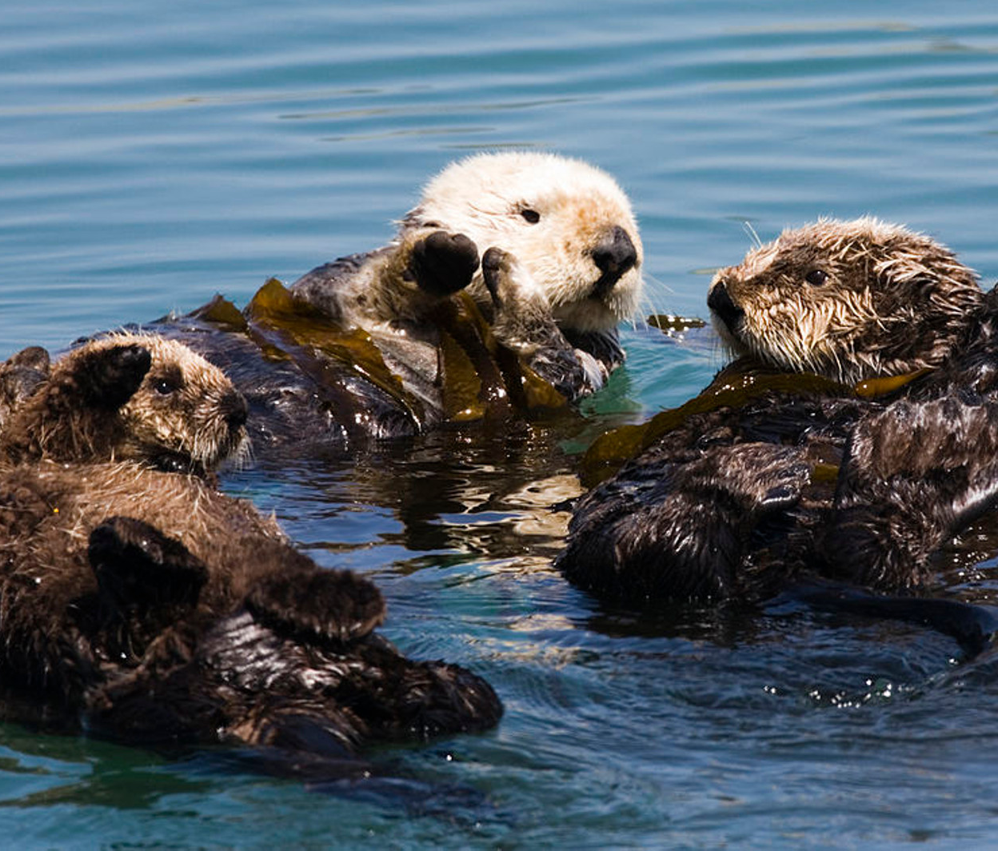
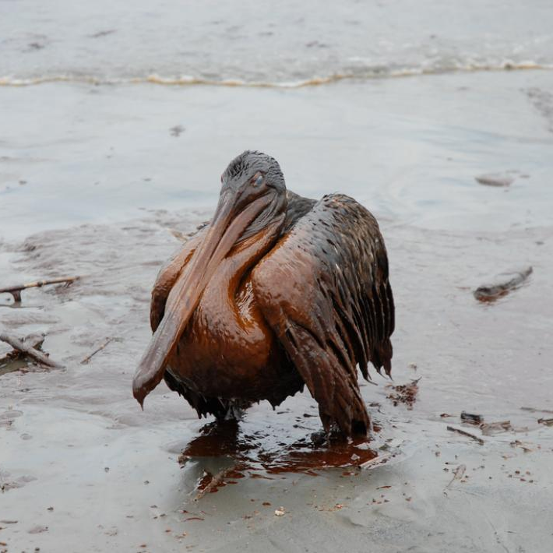
Non-Renewable Resources
What could be an alternative?
Not only are non-renewable resources running out...
They are also very bad for the health of us and our environment!

Slide 7
Renewable Resources
Renewable resources are the alternative to fossil fuels!
Renewables are infinite, natural and clean
Examples?

Slide 8
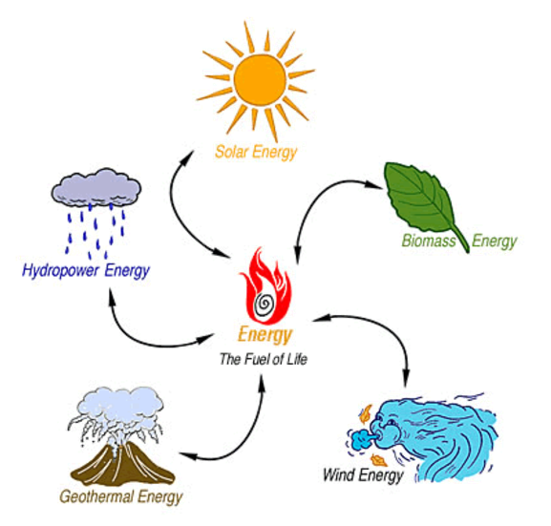
Renewable Resources
Examples include hydro energy, solar energy, geothermal energy, wind energy & biomass energy
Harnessed with solar panels, wind turbines, heat pumps, dams, etc.

Slide 9
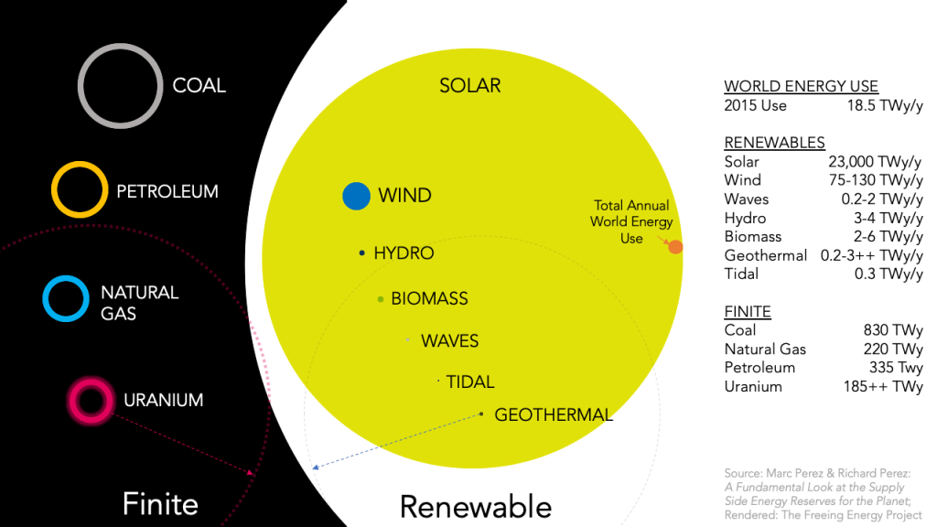
Why Solar Power?
Solar is ABUNDANT!
The sun provides enough energy in one day to power the whole world for a year

Slide 10
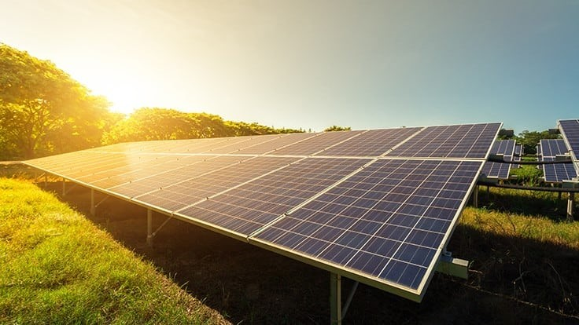
How Does Solar Power Work?
Solar power is collected using solar panels
These solar panels can be installed pretty much anywhere
They take heat energy as DC electricity and convert it into AC electricity, which is usable in our homes
These panels are directly connected to our home and feed us power in real time!

Slide 11
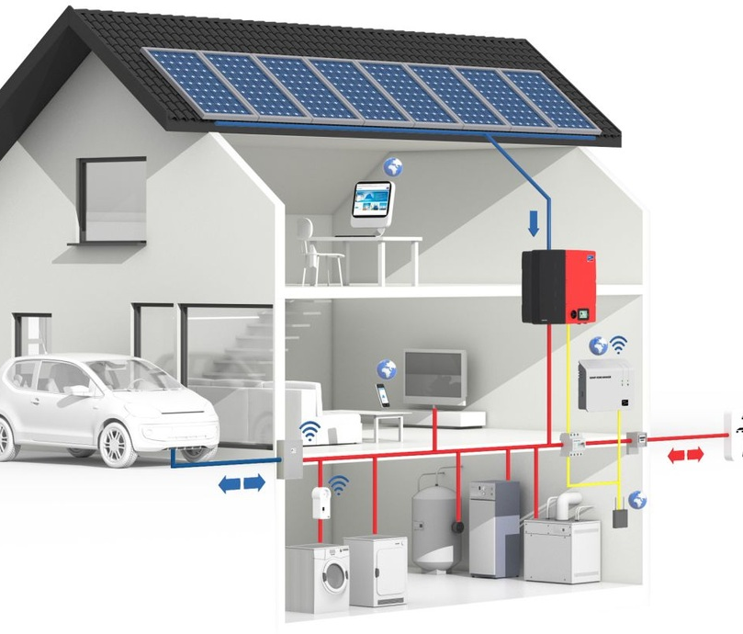
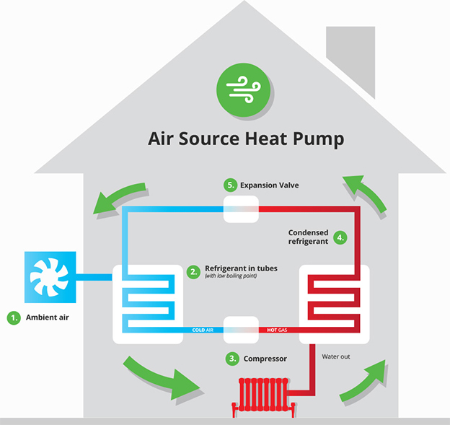
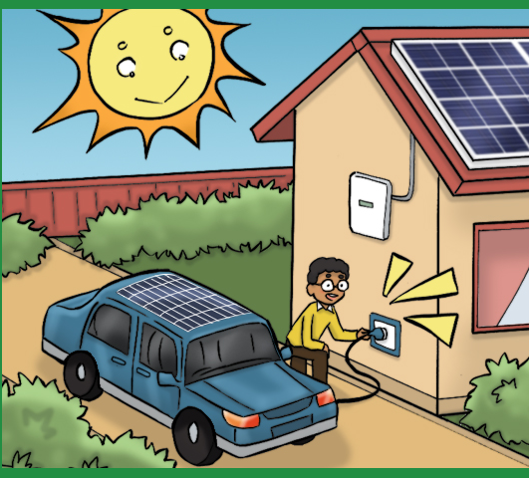
Where can Solar be used?
Solar can be used throughout your house to power many things... i.e. appliances, devices, tools
Solar can also be used to power air source heat pumps which can heat and cool your home in place of central air/heating
Solar can also power charging devices for electric vehicles
Heating and Cooling Your Home with Solar - Enjoy the Sun with Us! (revisionenergy.com)
Driving on Sunshine - Enjoy the Sun with Us! (revisionenergy.com)

Slide 12
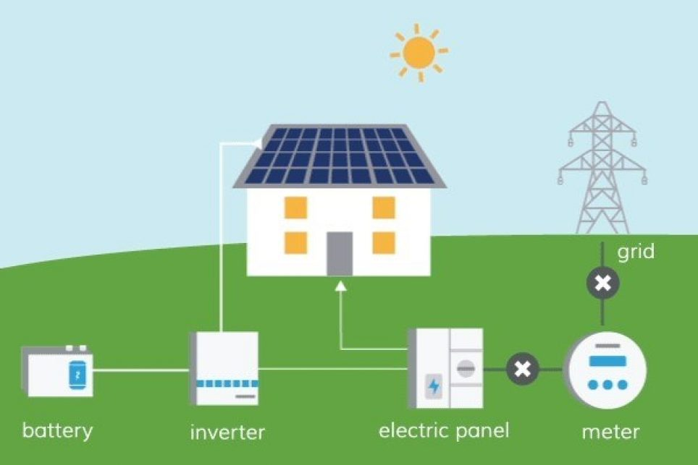
Where can Solar be used?
Solar power can also be stored in battery packs
This allows solar to be used at night or when it's storming- times our solar panels won't be able to generate enough power to keep our lights on!
Battery Backup to Solar Power - Enjoy the Sun with Us! (revisionenergy.com)

Slide 13
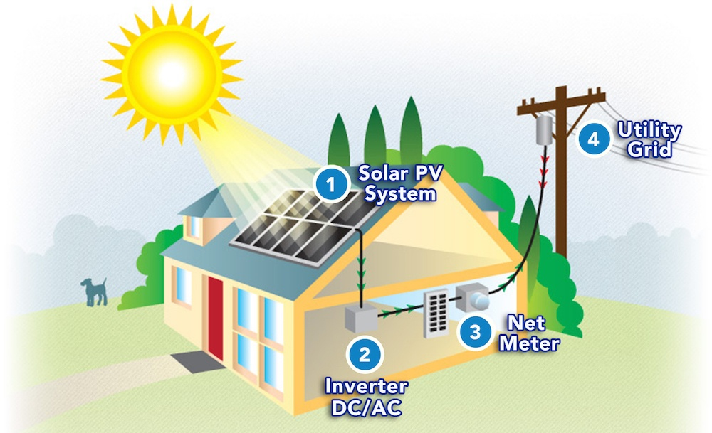
Extra Solar Power
What if you produce more solar power than you need to power your home?
Extra power gets fed to your neighbors so they power their houses partially on clean energy!
You receive credits for your energy contribution and then can spend them when needed
Net Metering!
How Solar Power Works - Enjoy the Sun with Us! (revisionenergy.com)

Slide 14
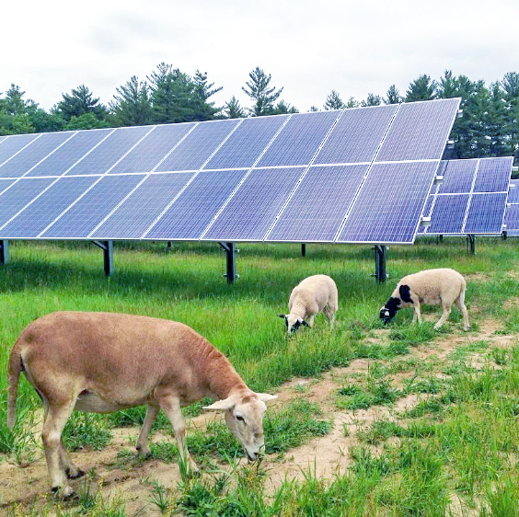
Community Solar
Solar power can also be used in unconventional ways and wider-spread ways!
Sheep & Solar allows people to lease solar panels on offsite properties
Solar is also used to power businesses, schools, even entire towns!

Slide 15
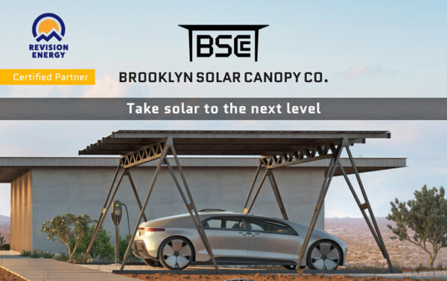
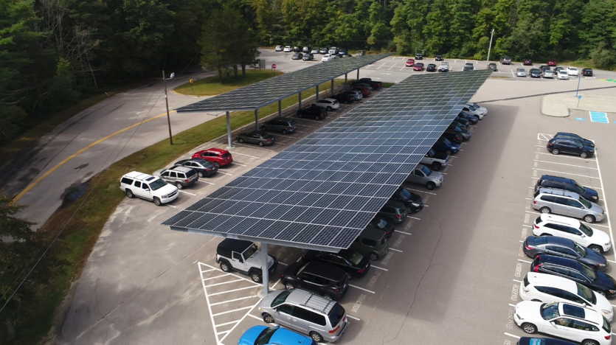
More Community Solar?
Solar power can also charge electric vehicles, on a larger scale
Carports to charge EVs and shade cars are great multipurpose structures

Slide 16
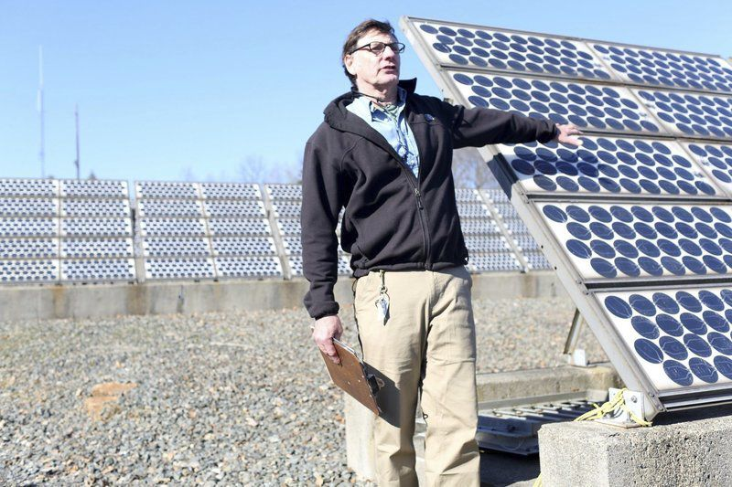
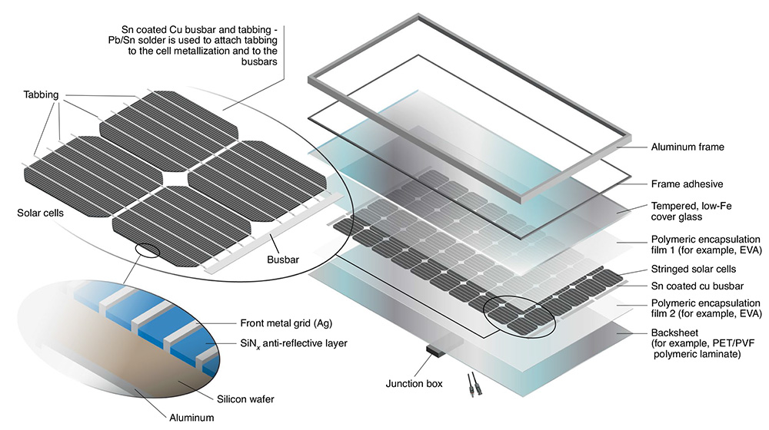
Solar Fun Facts
How long do solar panels last?
What happens after a solar panel stops working? Where does it go?

Slide 17
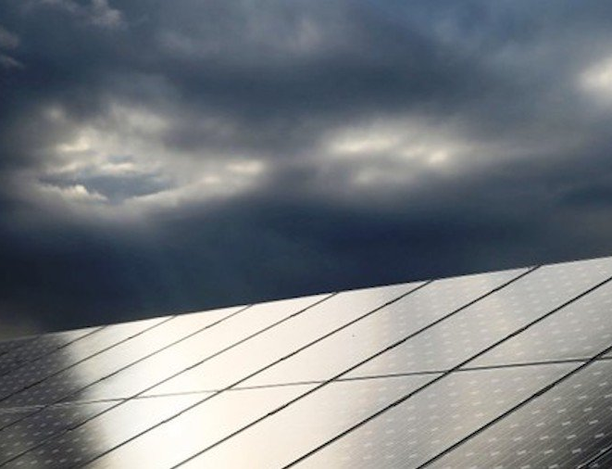
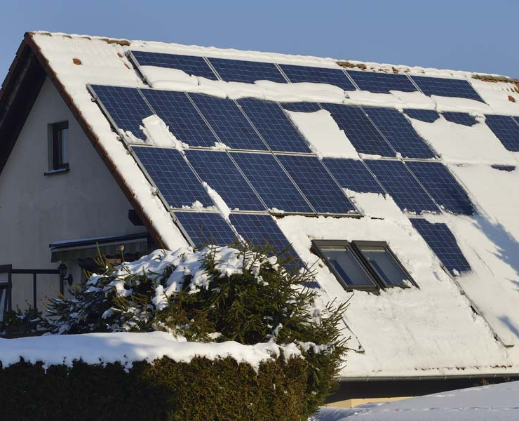
Solar Fun Facts
What do we do when it storms and it's cloudy?
Do solar panels work in the cold wintertime? Is the sun still generating heat during that half of the year?

